Slide 1

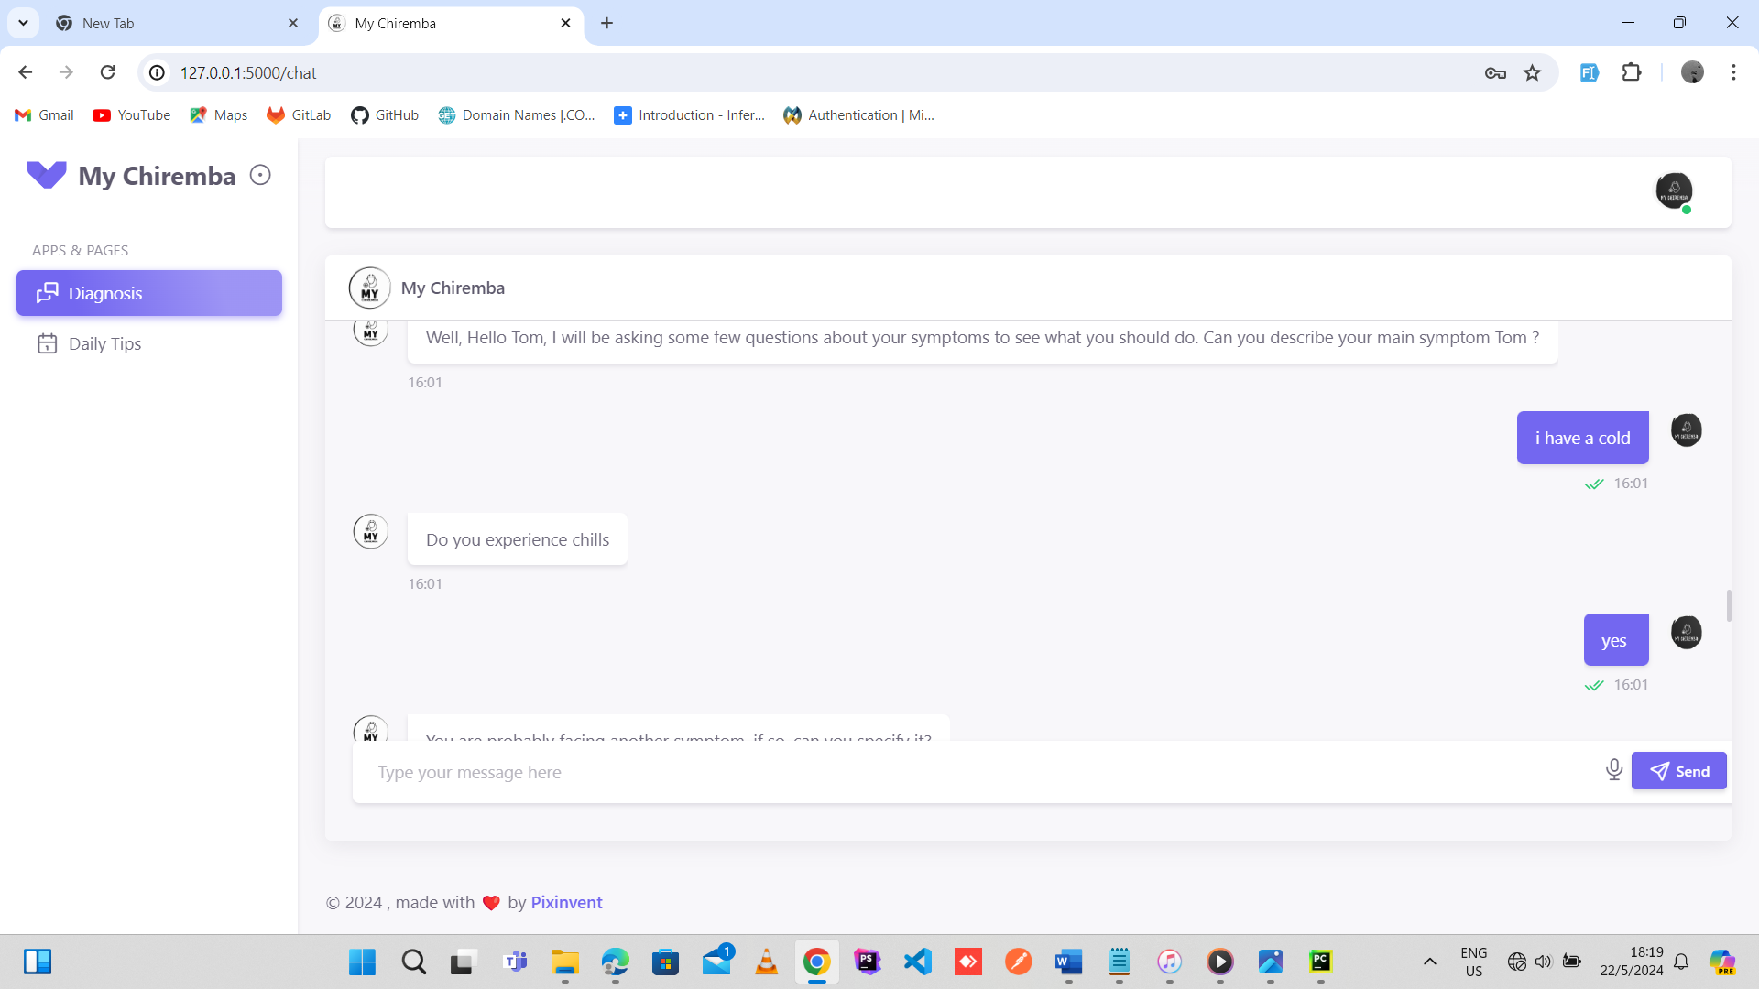
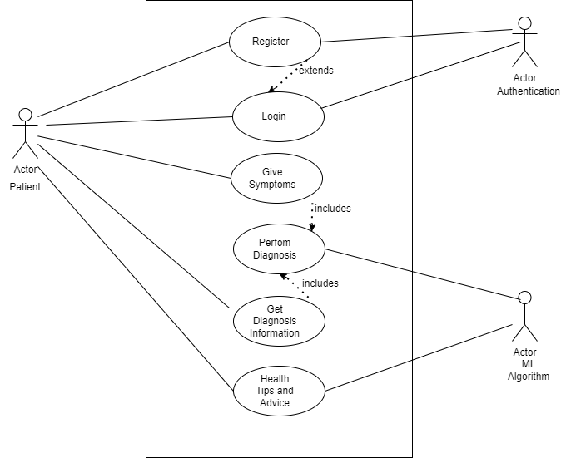
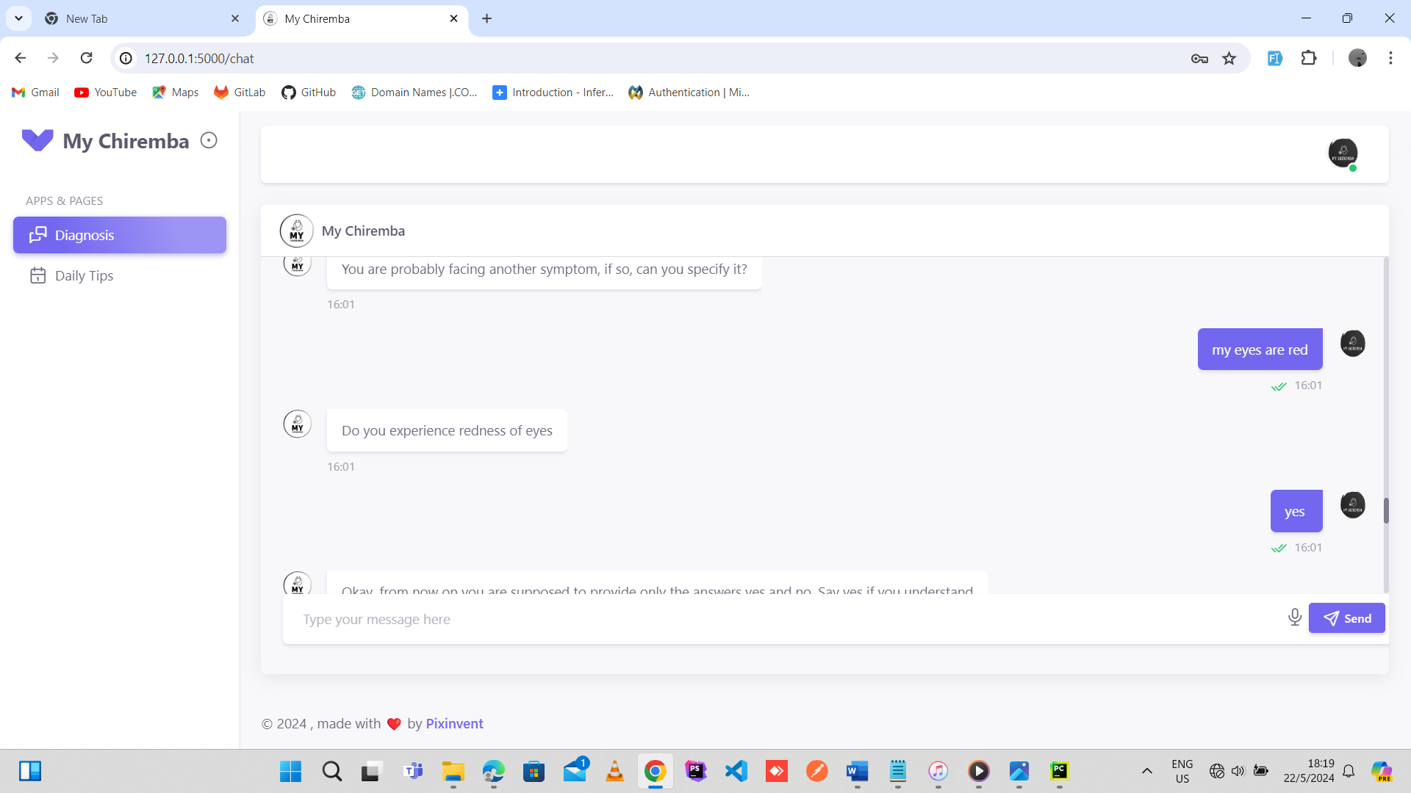
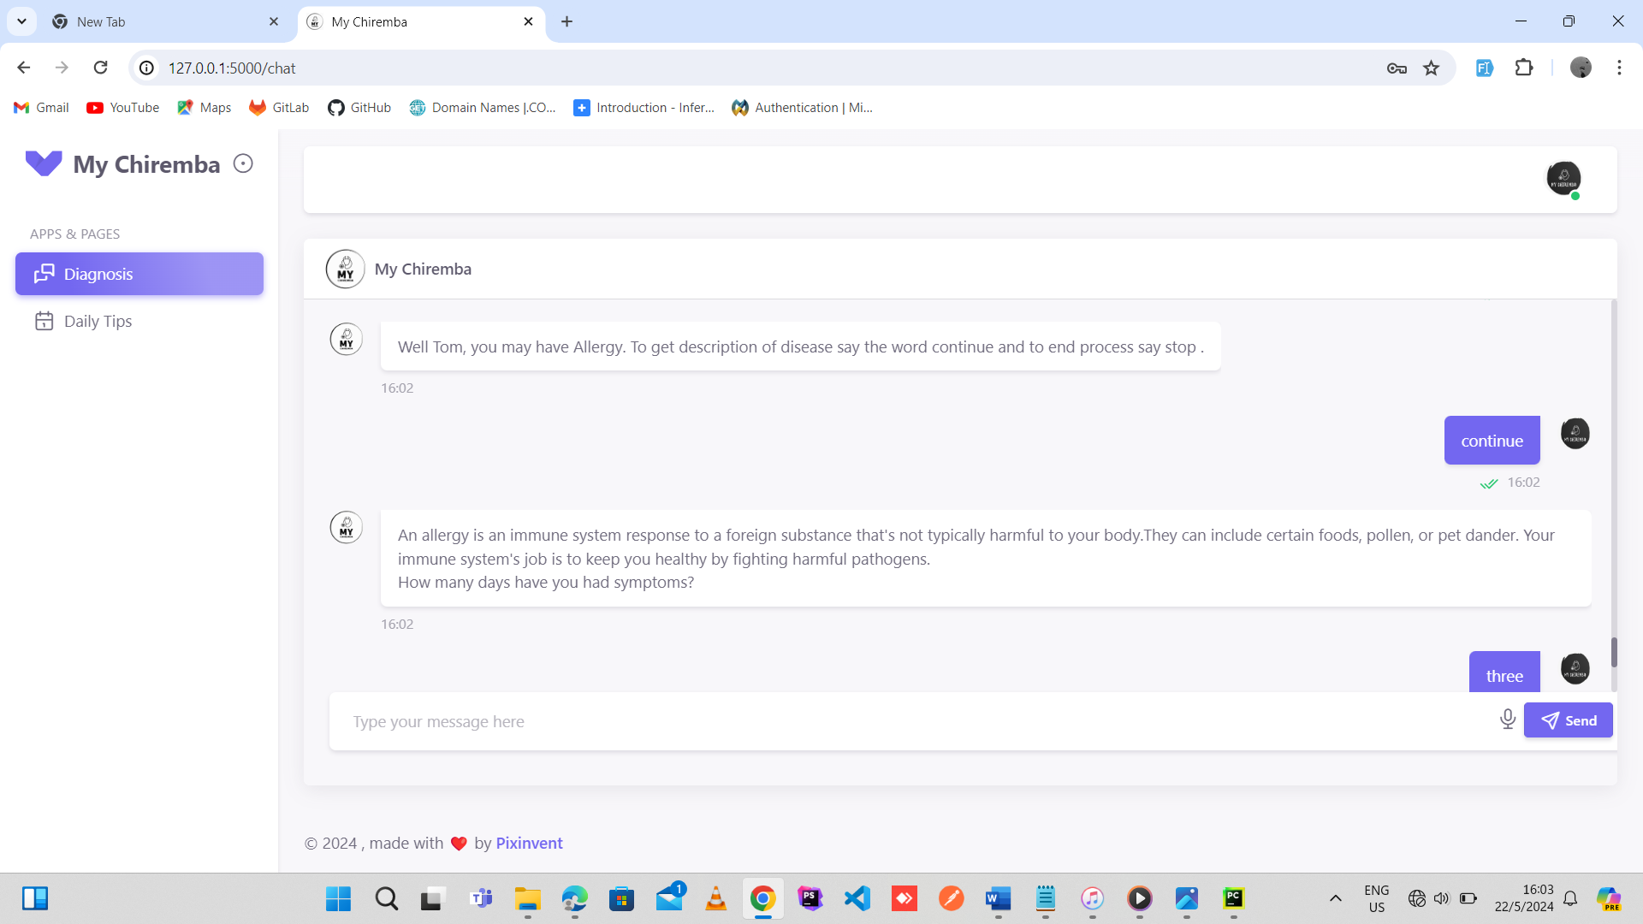
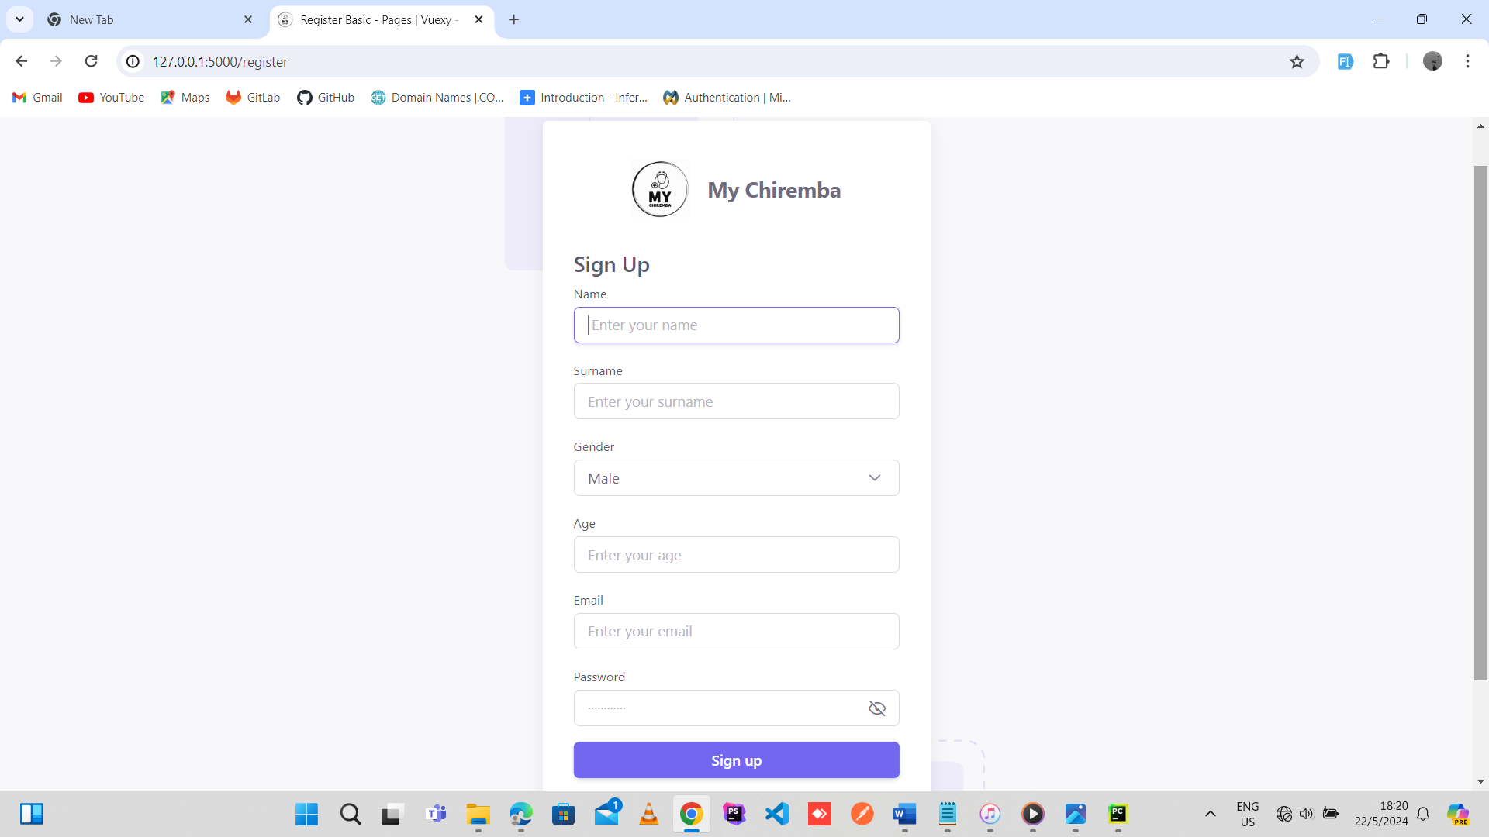
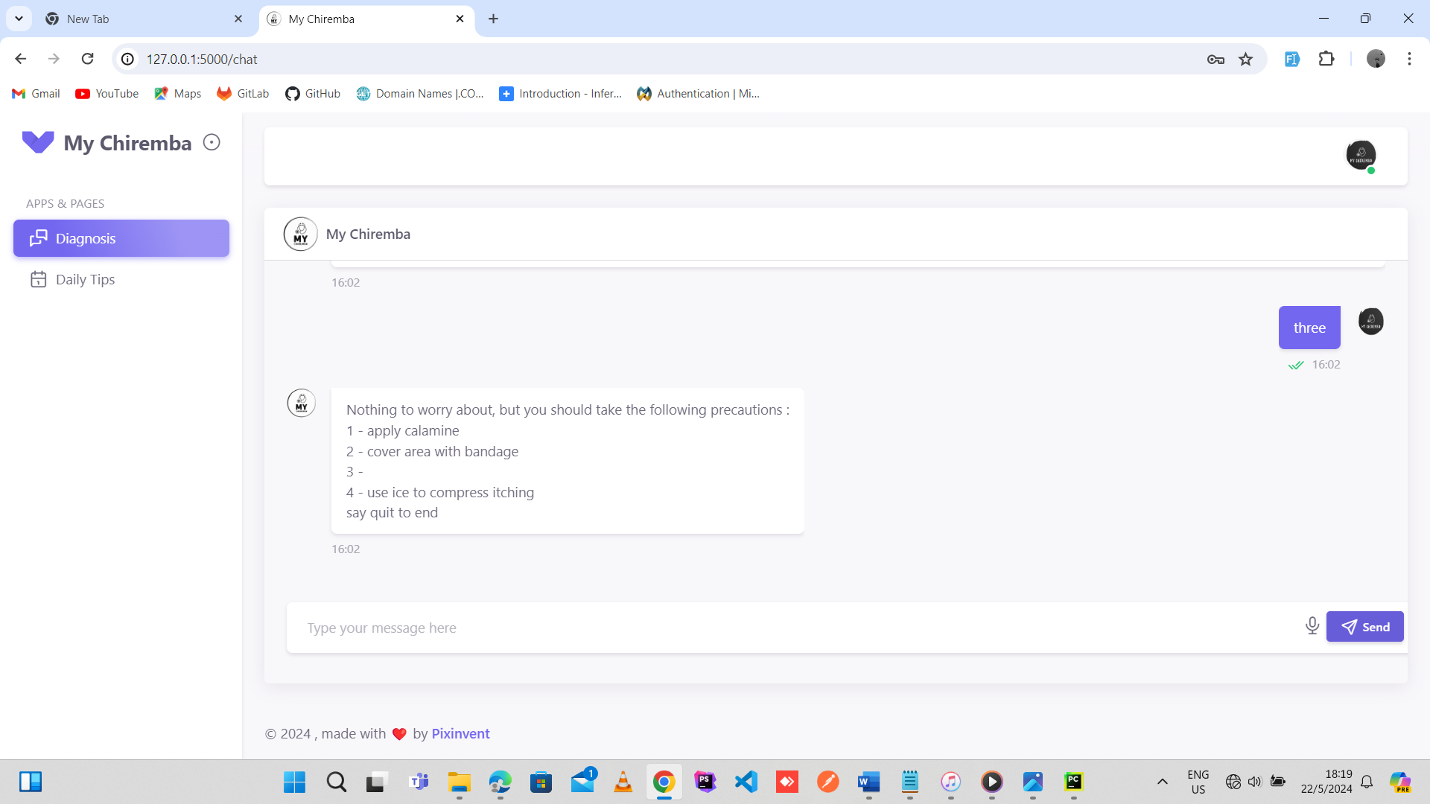
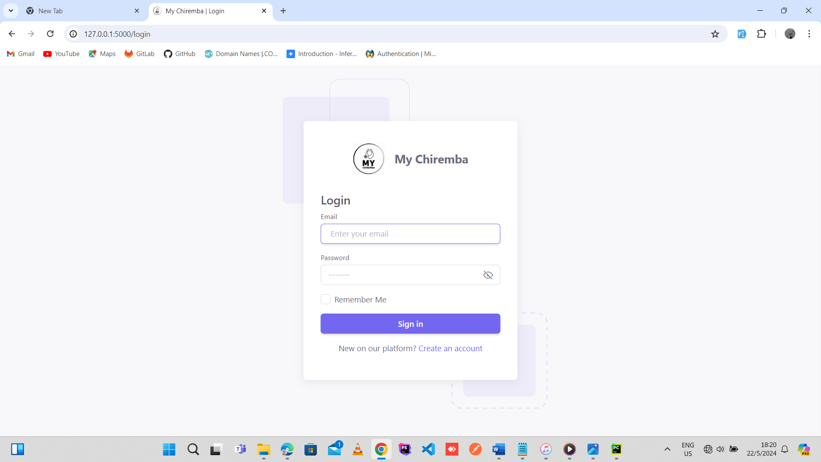
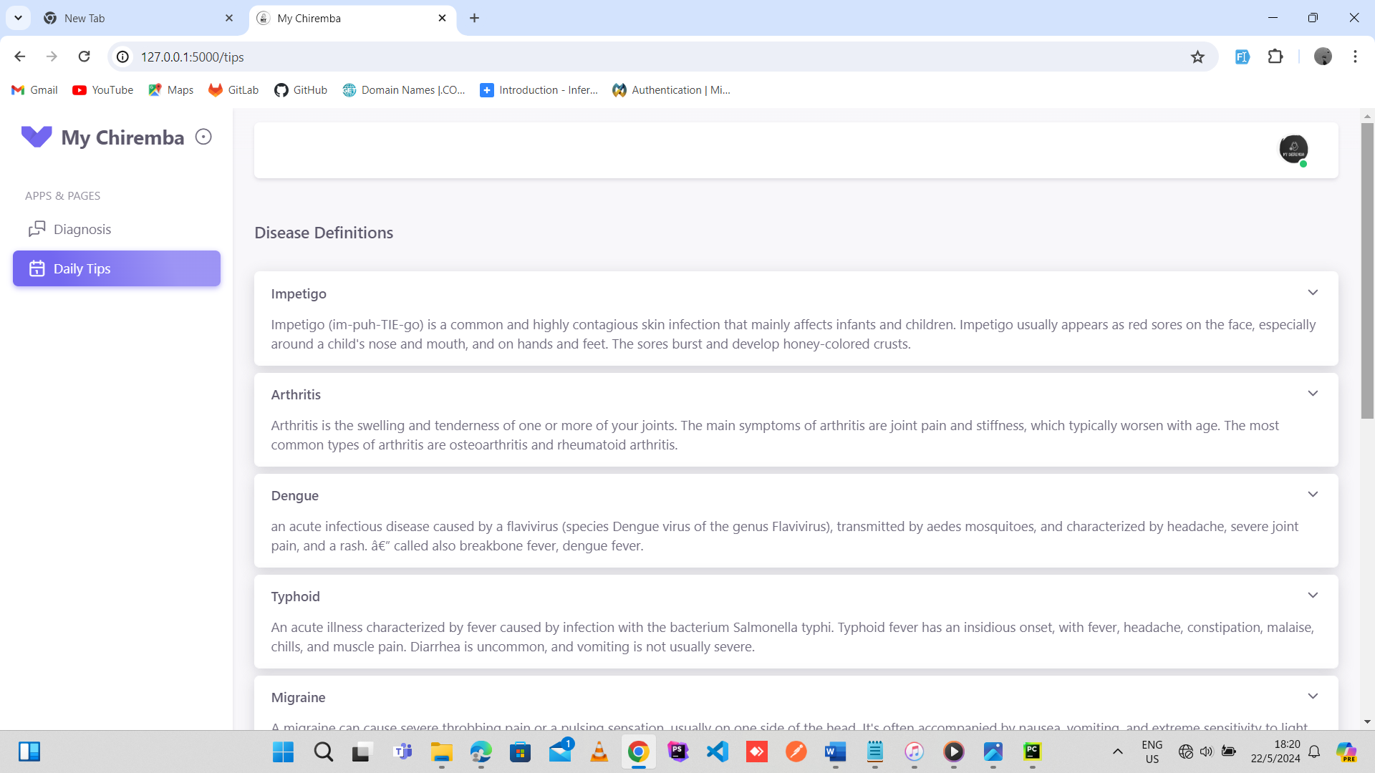
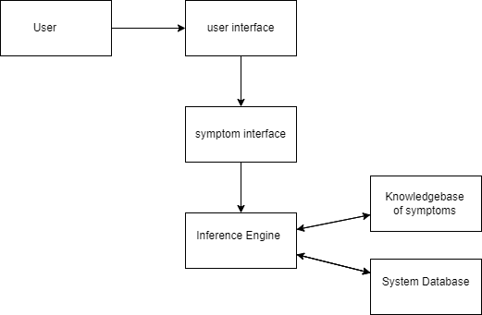
MY CHIREMBA
Simon Makowa - Software Engineering Department
1.0 Abstract
3.0. Problem definition
7.0. Use Case Diagram
This document proposes the next generation technology that everyone has been waiting for, a novel system that provides medical diagnosis assistance to users. The system is called My Chiremba. The system is designed to help users understand their symptoms and possible causes by guiding them through a series of questions to help narrow down symptoms to a possible diagnosis. The document also entails the root problems that drove the innovation of the system, investigations undergone and the objectives and scope that My Chiremba will have to meet.
Many patients lack access to medical professionals who provide accurate and timely diagnosis and treatment. This can be due to financial difficulties or the patients staying in remote or underserved areas where there are no nearby clinics or hospitals. (It is costly)
Healthcare providers often face time constraints in conducting comprehensive assessments and consultations with patients. The limited time available can lead to delays in treatment and ultimately poorer health outcomes for clients. (It takes too much time)
2.0. Introduction
The rapid pace of technological innovation has transformed nearly every aspect of our lives, revolutionizing the way we work, communicate, and even manage our health and wellbeing. In the field of healthcare, the integration of cutting-edge tools and techniques has ushered in a new era; of more efficient, effective, and personalized care; that promises to deliver more accurate diagnoses, targeted treatments, and preventive care tailored to the unique needs of each individual.
However, despite these strides, a stark reality persists. In many communities around the world, including Zimbabwe, a significant portion of the population continues to face daunting barriers when it comes to accessing quality healthcare services. Whether it's the prohibitive cost of visiting a doctor or the lack of essential medical equipment and diagnostic tools in underfunded healthcare facilities, these challenges have left far too many Zimbabweans with limited options for managing their health.
Evidence of the above claim is given by the research information below.
1. In an Al Jezeera article written on 28 April 2021 with the title Rich or poor, in Zimbabwe crumbling healthcare is deadly for all, the researcher tells the story of a Chitungwiza resident called Leonard Mugwade, who accompanied his neighbour to Chitungwiza Central Hospital where they were turned away because the neighbour was said to have had a non-crucial case, but then died before the Leonard could get $25 to take the person to another private hospital.
2. In a Herald article written on 03 January 2020 with the title public hospitals adjust charges, research showed that as of that time the consultation fees for adults receiving treatment at Parirenyatwa Group of Hospitals are up from $15 to $200 for initial and $130 for subsequent visits. Children above five years would pay $100 as initial consultation and $60 for reviews. In light of this information Mr Rusike then concluded by saying, the low-income population can no longer afford to get ill because they cannot afford expensive curative services.
This unacceptable state of affairs underscores the urgent need for innovative solutions that address the systemic barriers to quality healthcare, ensuring that every individual, regardless of their financial situation or geographical location, can access the care they deserve.
4.0. Overview of the developed application
My Chiremba is a medical assistant app capable of accurately diagnosing patients' diseases based on symptoms provided. The app provides real-time responses and uses natural language processing to help with the semantic analysis of the information that the user will be trying to convey. The app also gives daily health advices to the users based on personalized data of the user that he would have been diagnosed with in the system. The system helps improve the efficiency and accessibility of healthcare services, leading to earlier detection and treatment of illnesses which will improve the quality of healthcare in Zimbabwe
8.0. Screenshots
5.0. Objectives
To provide real-time interaction which uses natural language processing for semantic analysis of the description of symptoms
To provide a functionality for diagnosing a user based on given symptom
To provide a functionality for giving the users daily health advices
Conclusion
As the healthcare landscape continues to evolve, My Chiremba stands poised to play a pivotal role in empowering patients, reducing unnecessary medical costs, and fostering a more engaged and informed population. By democratizing access to medical expertise and putting the power of personalized healthcare guidance in the hands of users, the project seeks to redefine the way individuals manage their wellbeing and interact with the healthcare system.
6.0. System Overview
Supervisor – L. Amos

